Slide 1




Merck Animal Health Forecasting Project Week 13 Updates
Team: Abhishek Dixit, Benjamin Elbaz,
Anqi Huang, Shuang Wei
Advisor: Kris Iyer
Date: APR 7TH, 2016

Slide 2
Agenda
1 – Sales In Data Analysis
2 – 8-Month Forecast Sales In & Sales Out Results
3 – Questions from Midterm Presentation
Notes:
When presenting to the client, please briefly introduce yourselves first and introduce what part have you been working on in this project.

Slide 3
1 – Sales In Data Analysis
Old Sales In Data: January 2013 to November 2015
New Sales In Data:
Same data for 2013
Updated data for 2014.1 ~2016.3
Notes:
When presenting to the client, please briefly introduce yourselves first and introduce what part have you been working on in this project.

Slide 4
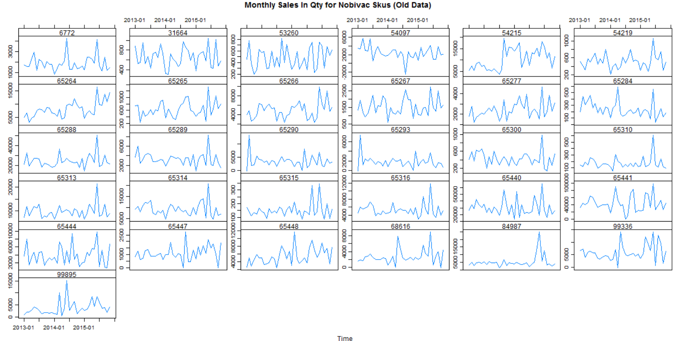
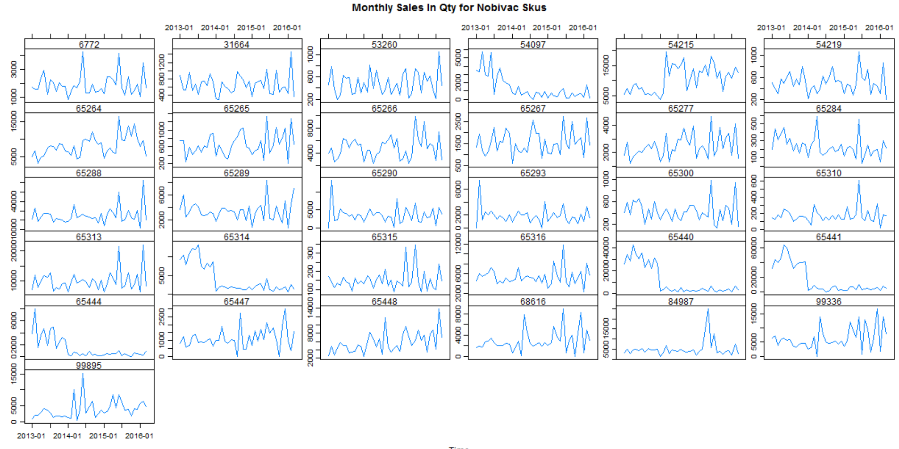
1 – Sales In Data Analysis
Old Sales In Plots from (2013.1~2015.11)
New Sales In Plots from (2013.1~2016.3)
Notes:
When presenting to the client, please briefly introduce yourselves first and introduce what part have you been working on in this project.

Slide 5
1 – Sales In Data Analysis Cont.
Old Sales In Plots from (2013.1~2015.11)
New Sales In Plots from (2013.1~2016.3)
Notes:
When presenting to the client, please briefly introduce yourselves first and introduce what part have you been working on in this project.

